Slide 1
VETERINARY PRACTICE MANAGEMENT SYSTEM
WITH CHATBOT
CREATED BY:
GROUP NO:9
A05 - AYUSHI MISTRY
B22 - TANYA JAGYASI
B50 - RAHUL PATEL

Slide 2
ABOUT
The goal of this application is to create tool for managing the work flow of a veterinarian. This application is assigned to keep track of patients, appointments, procedures and medication.
We are using a chatbot to stimulate human conversation. Chatbot is basically a user interface (UI),but instead of going through a complicated UI, a system integrated with a chatbot is preferred.

Slide 3


INDEX
Company Profile
Project Profile
System Requirement
Existing System
Proposed System
Admin panel Screenshots
Reports
Screen Layout
Conclusion

Slide 4
Company Profile
Company Name : Cremisoft Development Pvt. Ltd.
Owner Name : Sunil Jagyasi
E-mail : sunil@cremisoft.com
Contact No : 7567002073

Slide 5
Project Profile
System Requirement
Existing System
Proposed System

Slide 6
System Requirement
Software Used:
Frontend:
Visual Studio Code/PyCharm
For Python and AI Chatbot
For Xml
Odoo Framework
Backend:
PHPmyAdmin
For Postgresql

Slide 7
Existing System
Veterinary Management ERP technology solutions at Hvantage Technologies Which Has Following Features:
Pet information portal
Appointment scheduling
Laboratory inventory
Notification reminder
ICU information portal
Invoice Records
Paediatrics details
Warehouse management records

Slide 8
Proposed System
The project maintains two levels of users:-
Administrator Level
User Level :-
Client
Employee
Doctor
Which includes Activities like
Maintaining Pet Details,Providing Prescription and Diet Advice.
Providing and Maintaining all Kinds of tests for Billing and Report generation.

Slide 9
Proposed System
AI ChatBot :- The chatbot platform processes users query, also once interpreted, it enquires about it in common language and passes this information to the user in a way that user understands.

Slide 10
MODULES
Admin Module:
Admin can add doctors and also update and delete it.
Inventory Control Management and Purchasing.
Admin can view the appointment and invoice.
Admin can also manage payment activities if require.
Can view user’s feedback
Doctor Module:
Can login
View and Confirm appointment
Can view Pet’s history about treatment
User Module:
User can register and login.
Can view the doctors.
Book an appointment
User can reschedule an appointment
Can view reports and invoice
Make an payment using Cash or Card
Can view history of treatment
Can Communicate with doctors in case of emergency(when doctor is available)
Can Communicate with chatbot

Slide 11
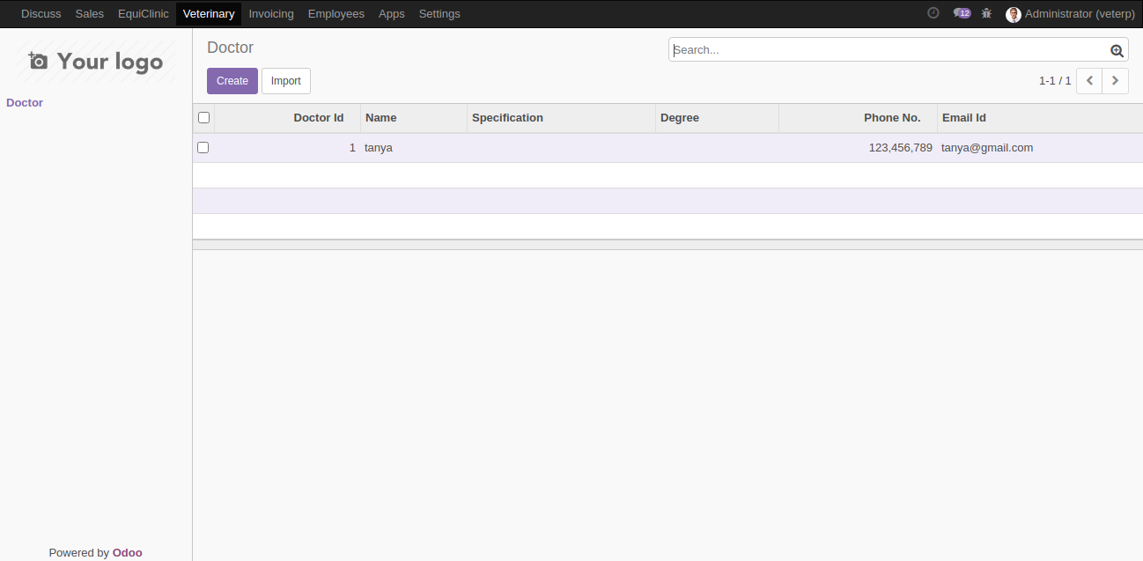
ADMIN PANEL SCREENSHOTS

Slide 12
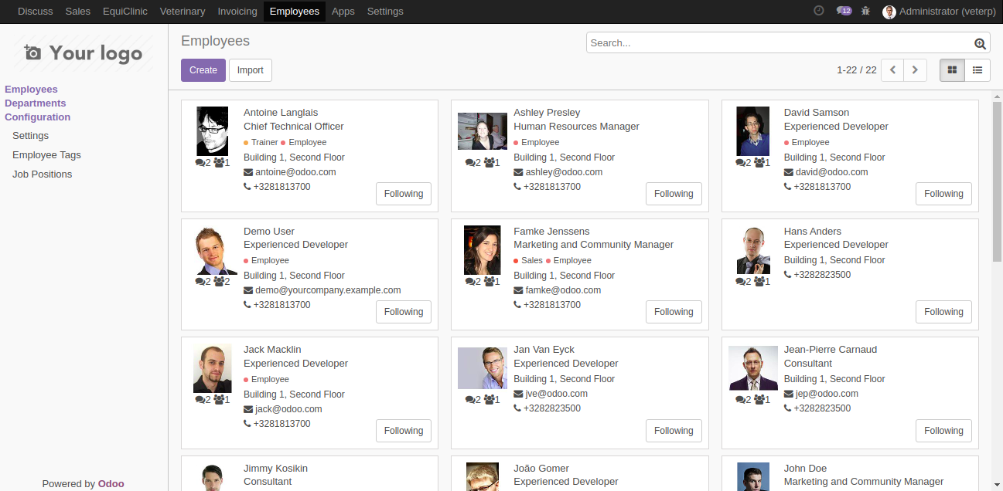
ADMIN PANEL SCREENSHOTS

Slide 13
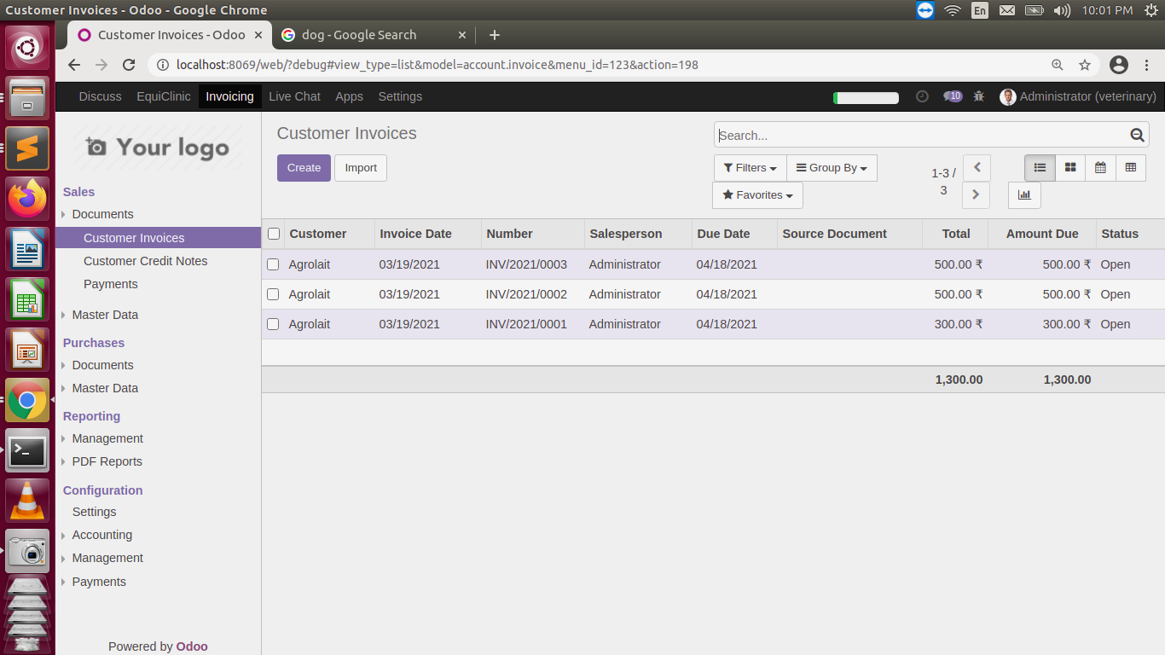
ADMIN PANEL SCREENSHOTS

Slide 14
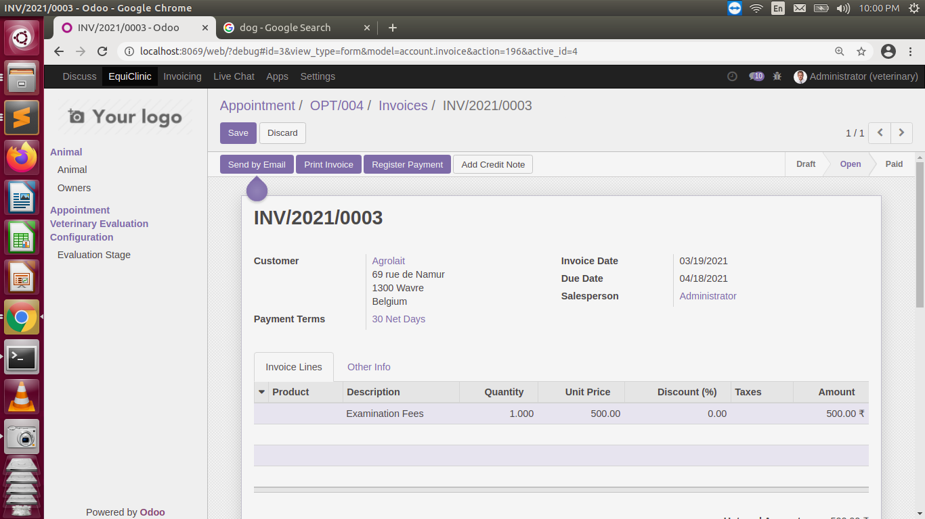
ADMIN PANEL SCREENSHOTS

Slide 15
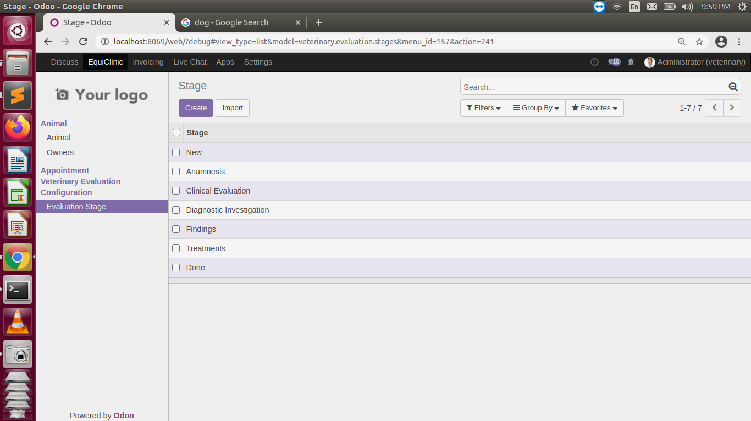
ADMIN PANEL SCREENSHOTS

Slide 16
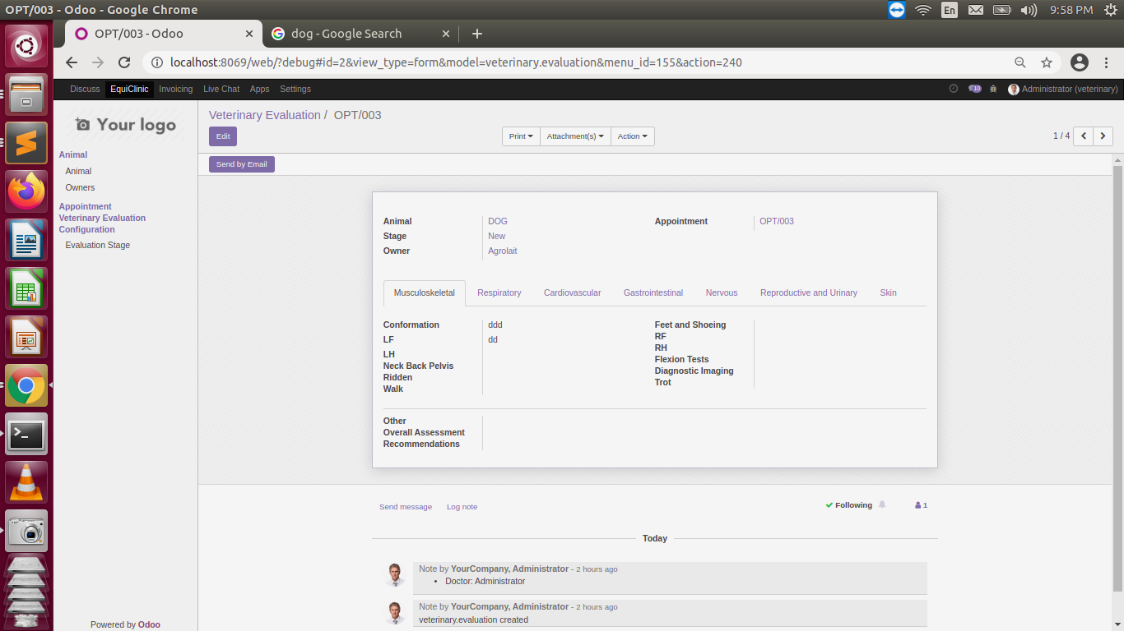
ADMIN PANEL SCREENSHOTS

Slide 17
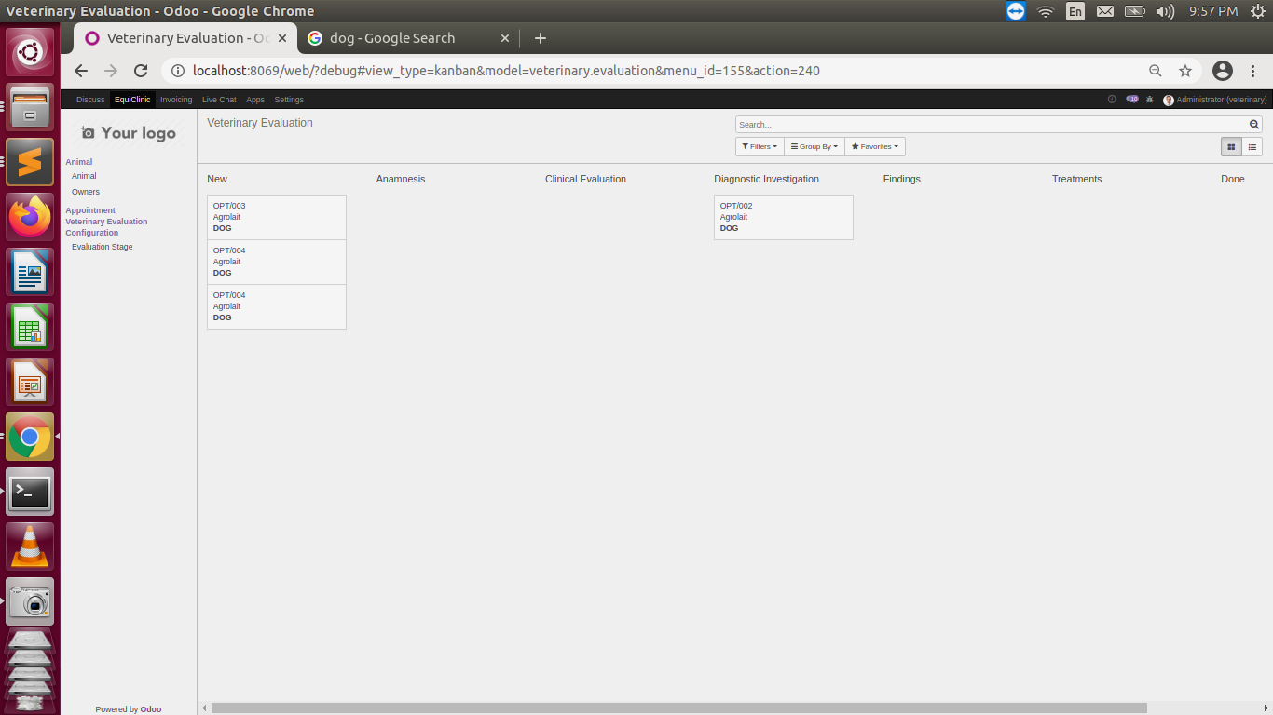
ADMIN PANEL SCREENSHOTS

Slide 18
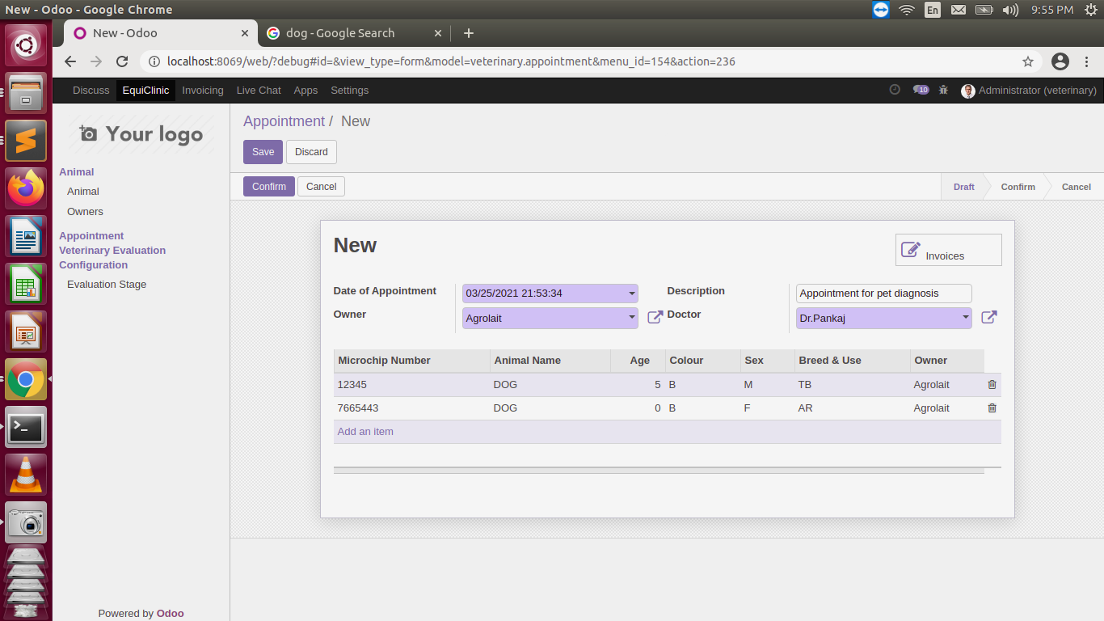
ADMIN PANEL SCREENSHOTS

Slide 19
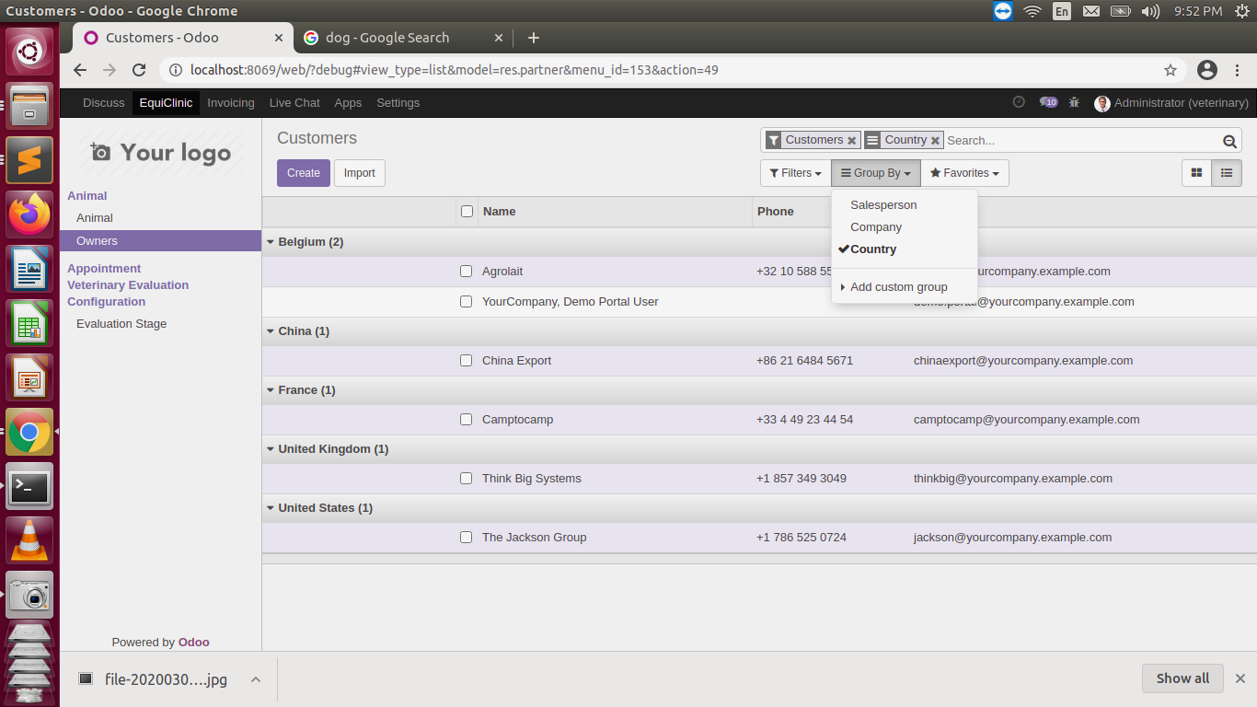
ADMIN PANEL SCREENSHOTS

Slide 20
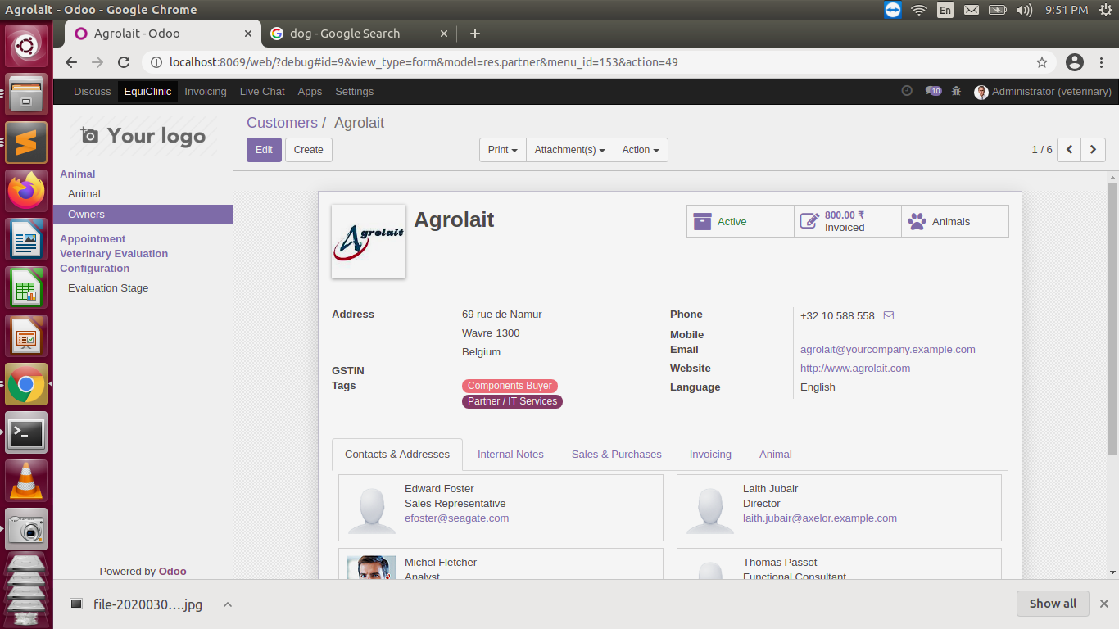
ADMIN PANEL SCREENSHOTS

Slide 21
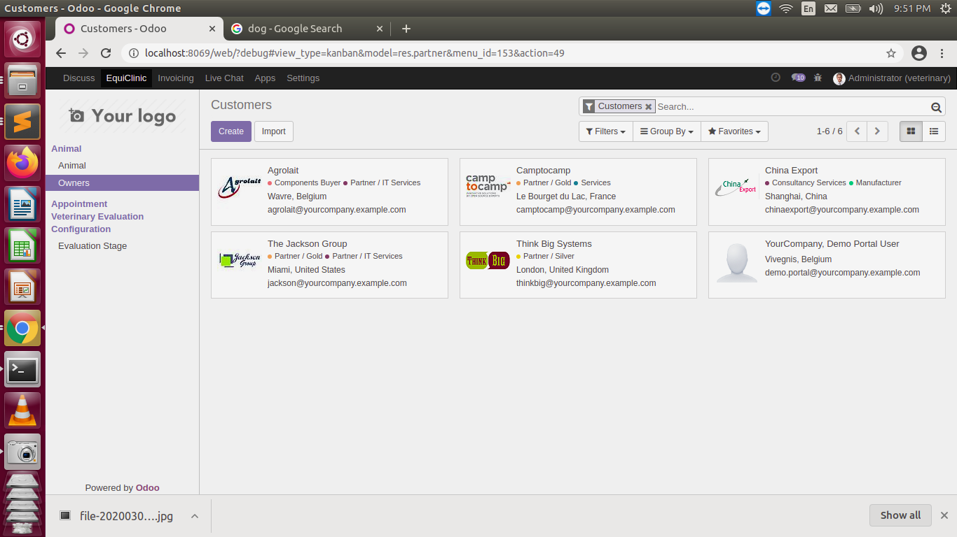
ADMIN PANEL SCREENSHOTS

Slide 22
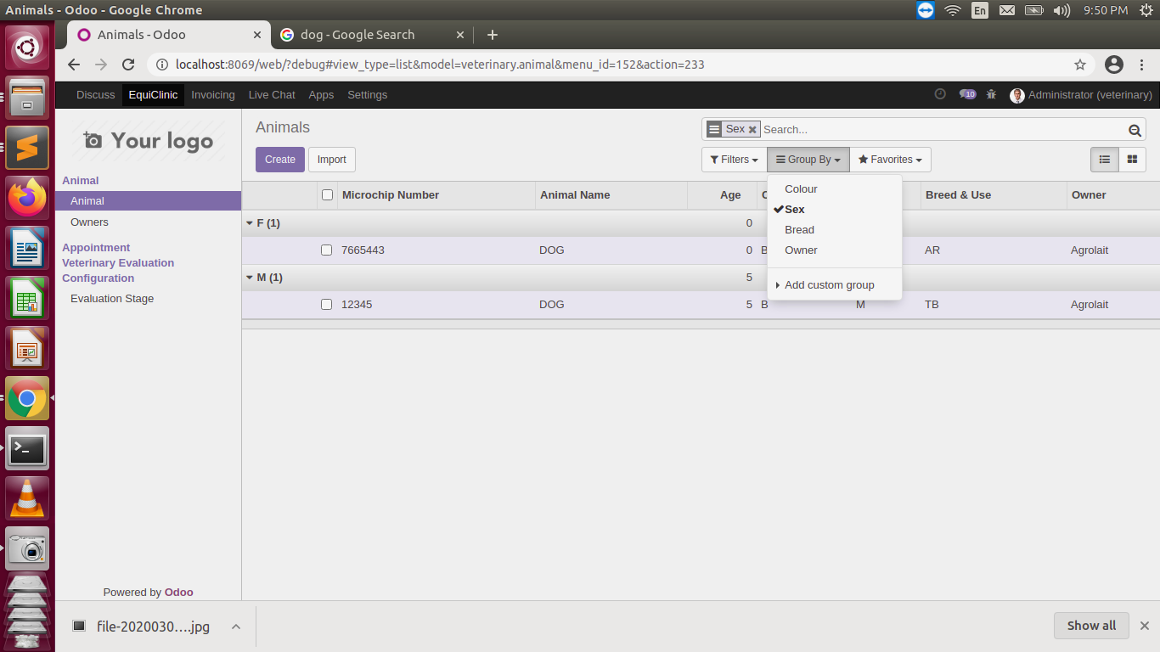
ADMIN PANEL SCREENSHOTS

Slide 23
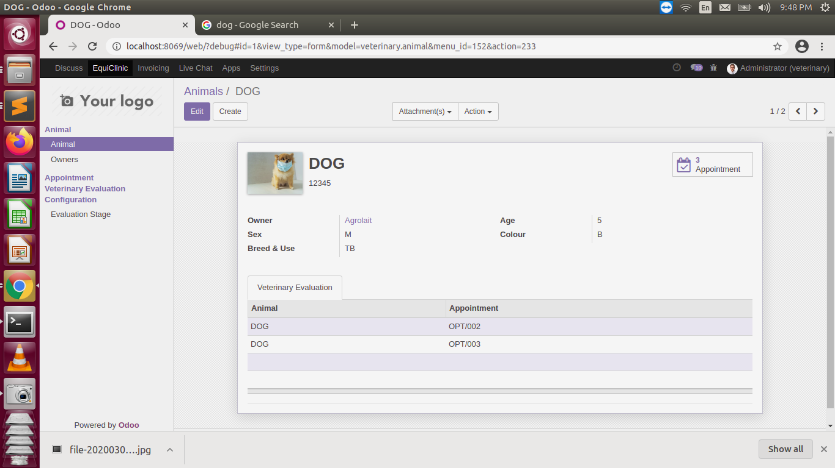
ADMIN PANEL SCREENSHOTS

Slide 24
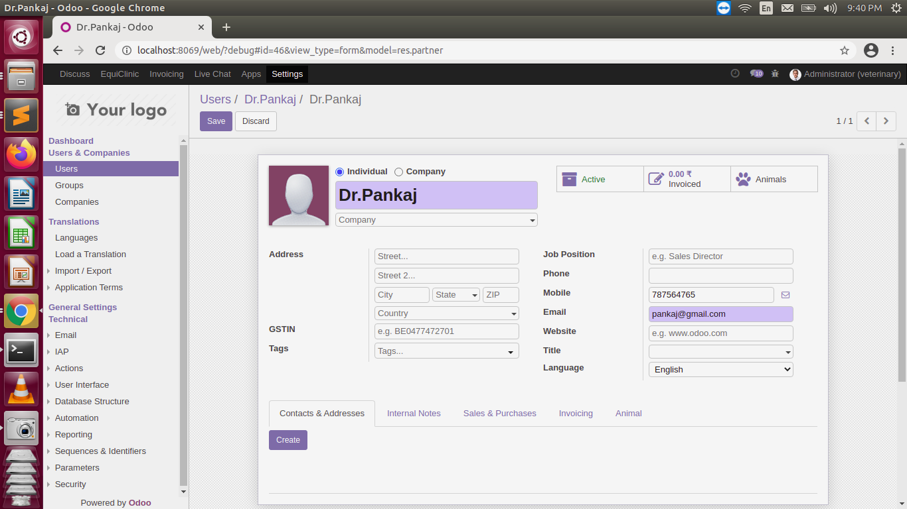
ADMIN PANEL SCREENSHOTS

Slide 25
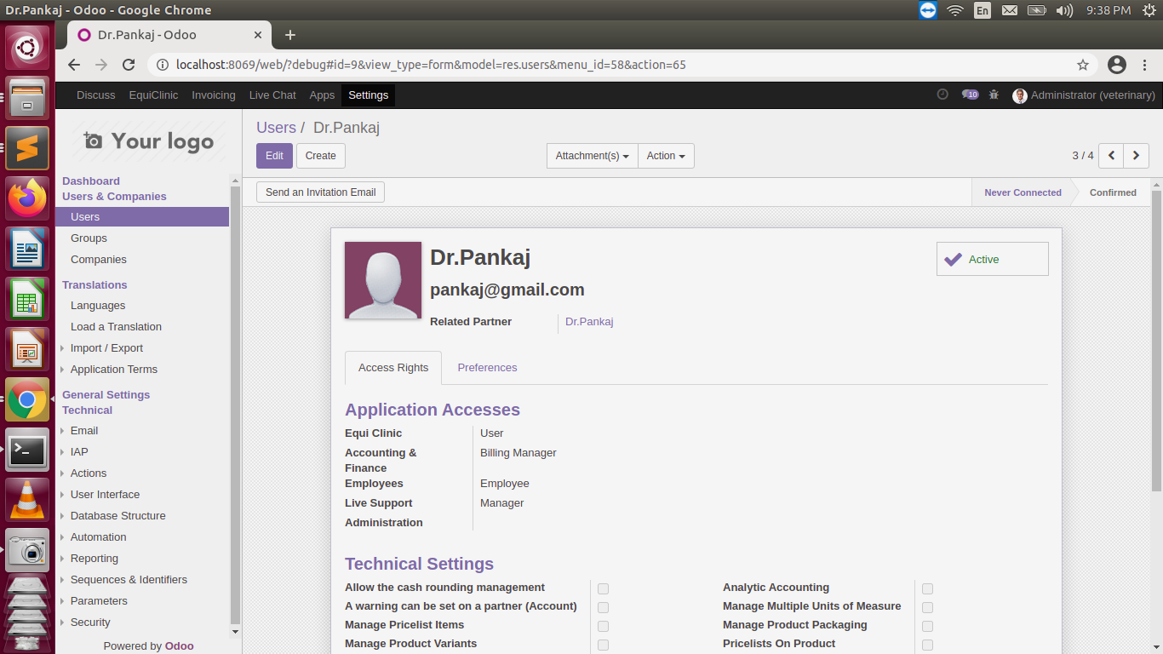
ADMIN PANEL SCREENSHOTS

Slide 26
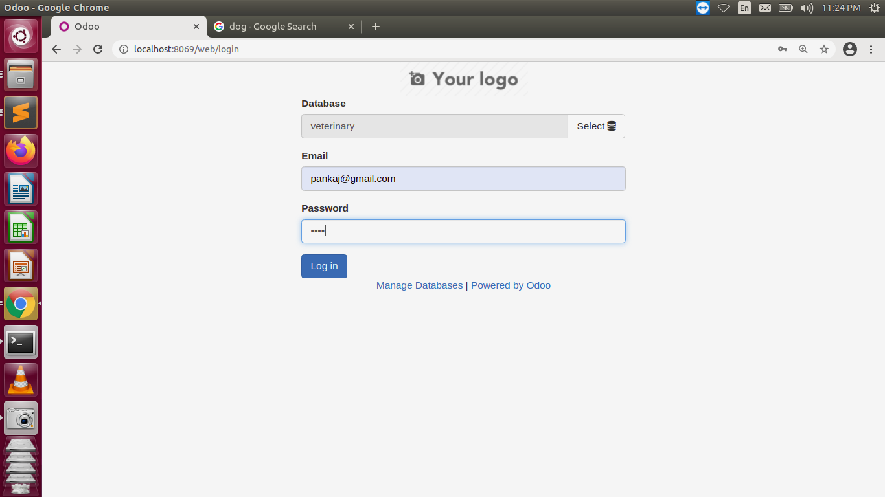
SCREEN LAYOUT

Slide 27
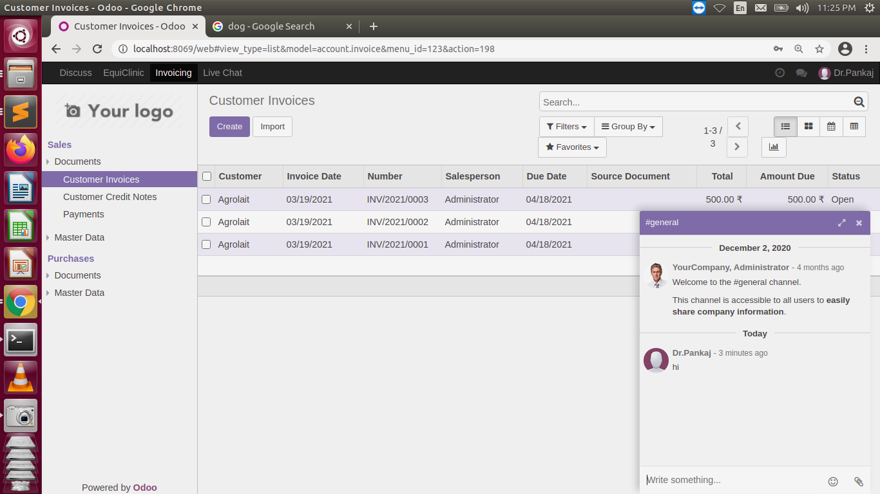
SCREEN LAYOUT

Slide 28
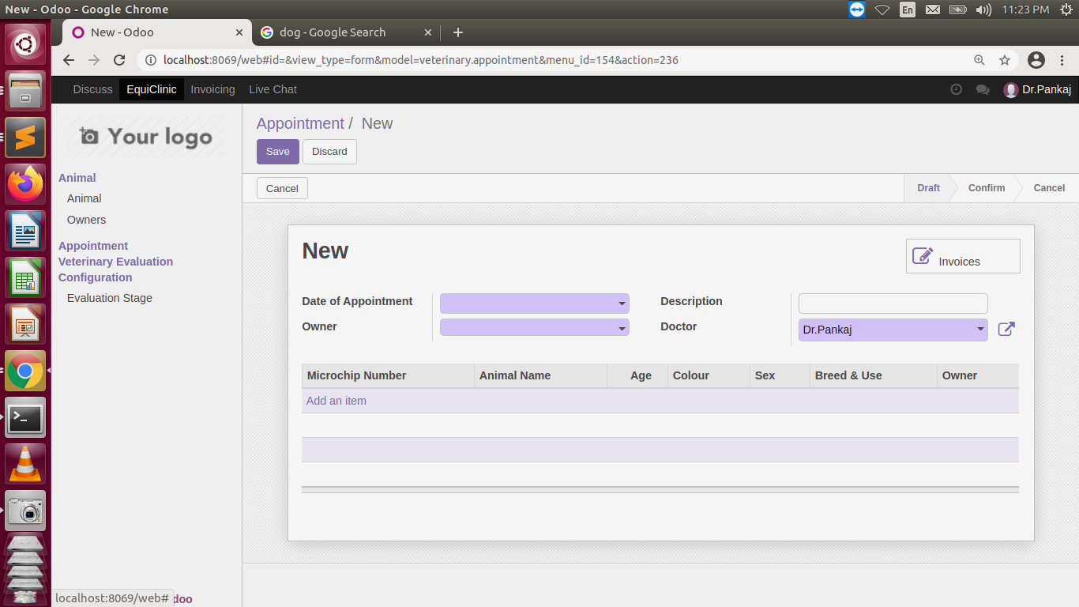
SCREEN LAYOUT

Slide 29
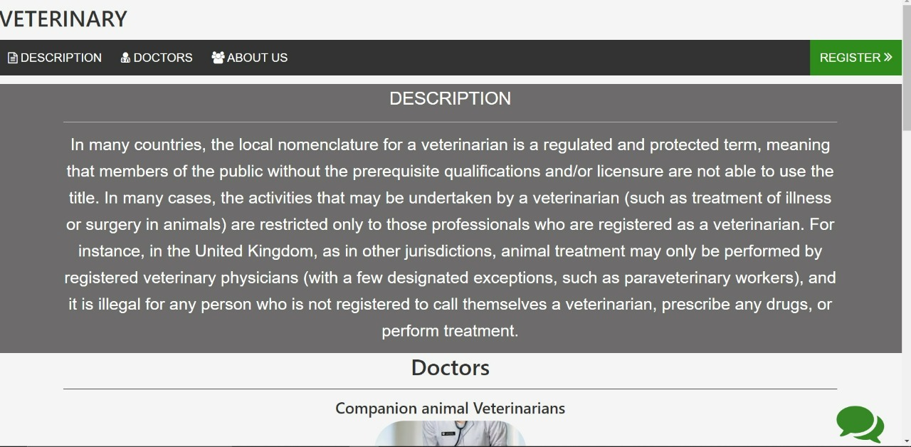
SCREEN LAYOUT

Slide 30
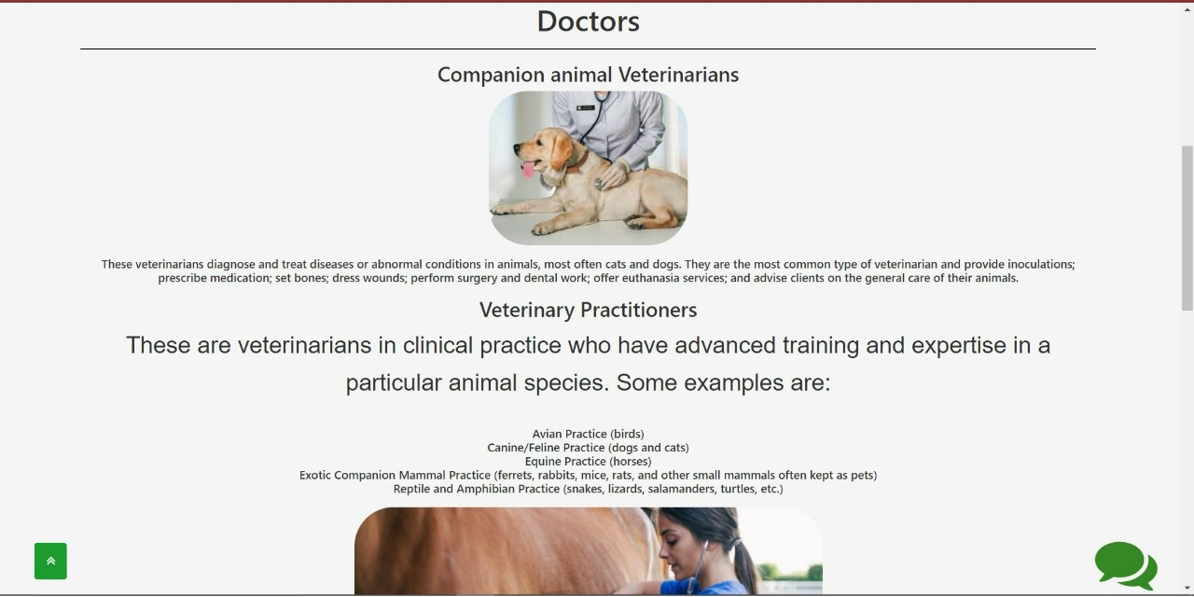
SCREEN LAYOUT

Slide 31
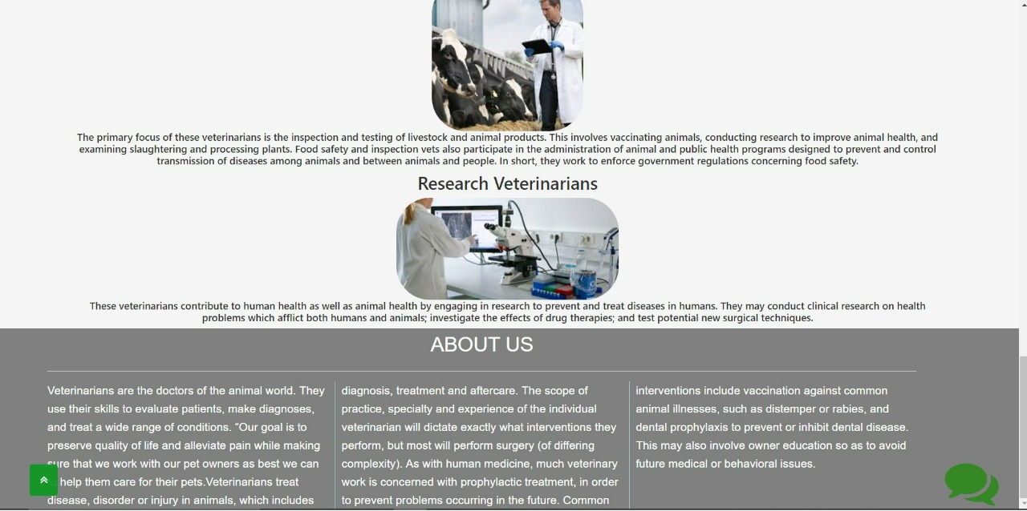
SCREEN LAYOUT

Slide 32
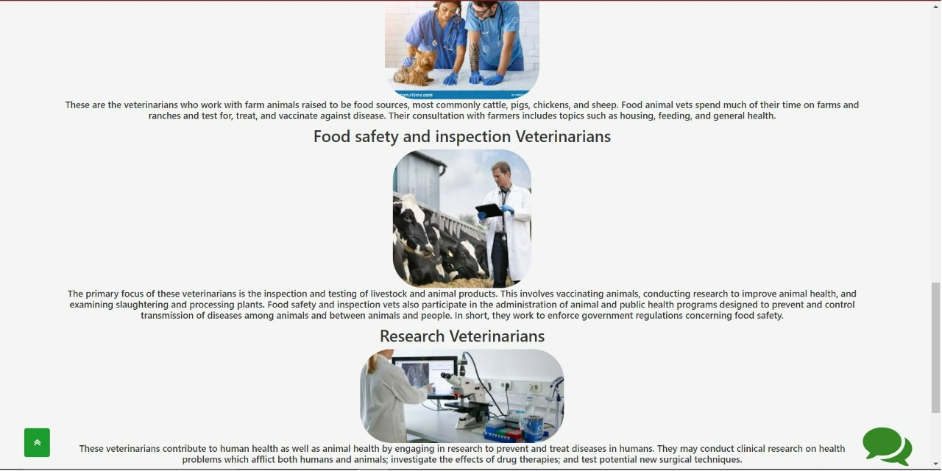
SCREEN LAYOUT

Slide 33
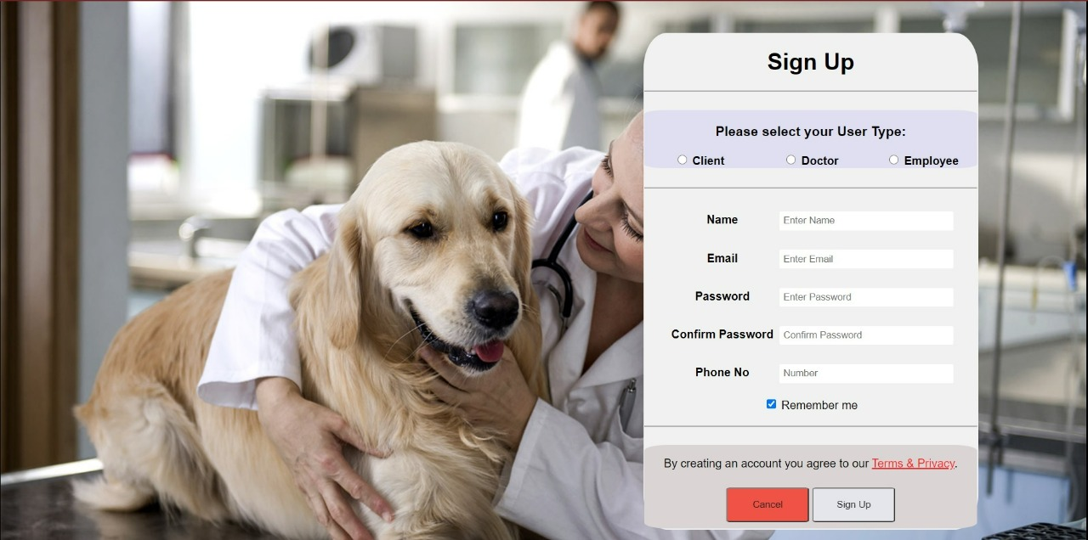
SCREEN LAYOUT

Slide 34
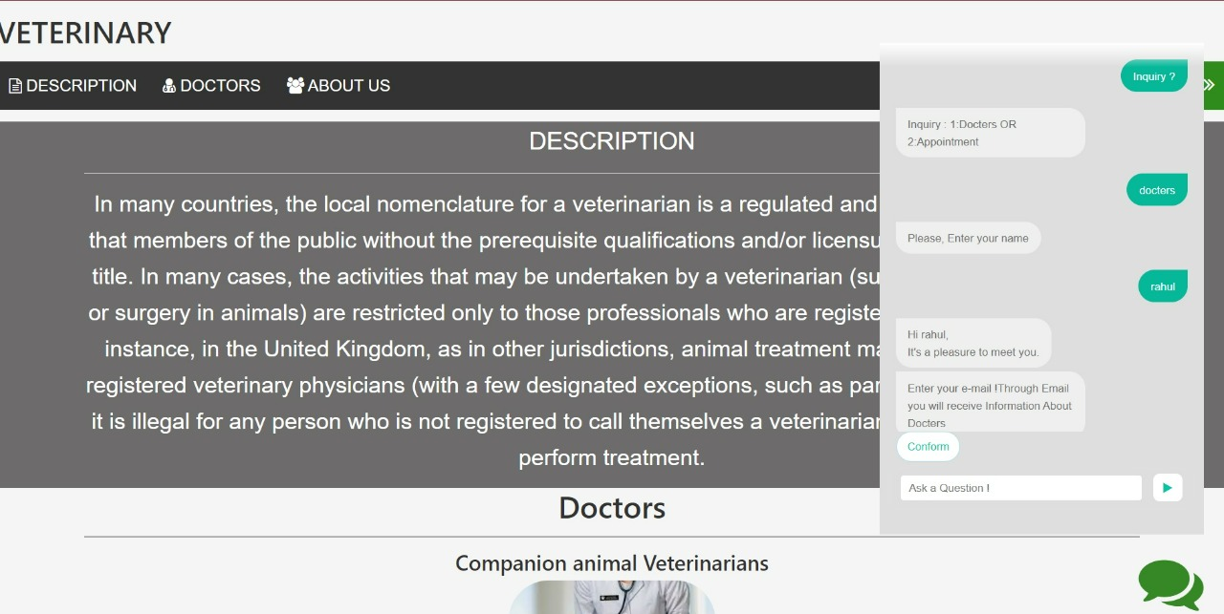
SCREEN LAYOUT

Slide 35
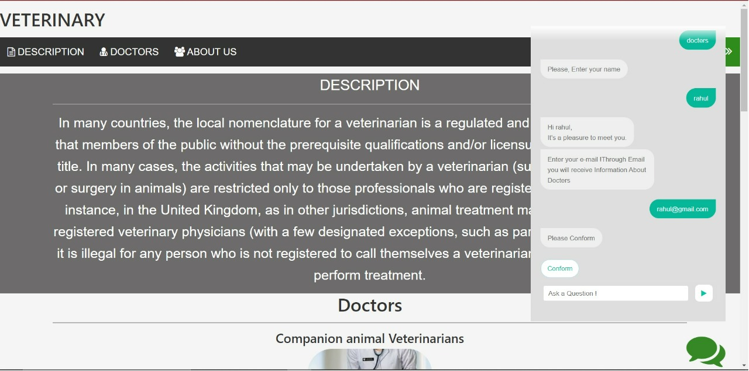
SCREEN LAYOUT

Slide 36
Conclusion
The project “Veterinary Practice Management System” is for computerizing the working in a hospital. The software takes care of all the requirements of an average hospital and is capable to provide easy and effective storage of information related to patients that come up to the hospital.
It generates test reports; provide prescription details including various tests, diet advice, and medicines prescribed to patient and doctor. It also provides injection details and billing facility on the basis of patient’s status whether it is an indoor or outdoor patient.
The system also provides the facility of backup as per the requirement. And it also has an AI Chatbot for the users,so that they will be able to interact for their problems.

